Slide 1
Pre-Apprenticeship Models
August 11, 2021

Slide 2
Agenda
Welcome and introductions
Overview of registered apprenticeship and pre-apprenticeship
Review Jobs For the Future (JFF) Framework
Examine sample programs
Regroup and next steps
ApprenticeshipNH.com/HighSchool

Slide 3
Today’s Objectives
Understand the elements and structure of high- quality pre-apprenticeships.
Identify potential pre-apprenticeship models for NH
Identify action steps
ApprenticeshipNH.com/HighSchool

Slide 4
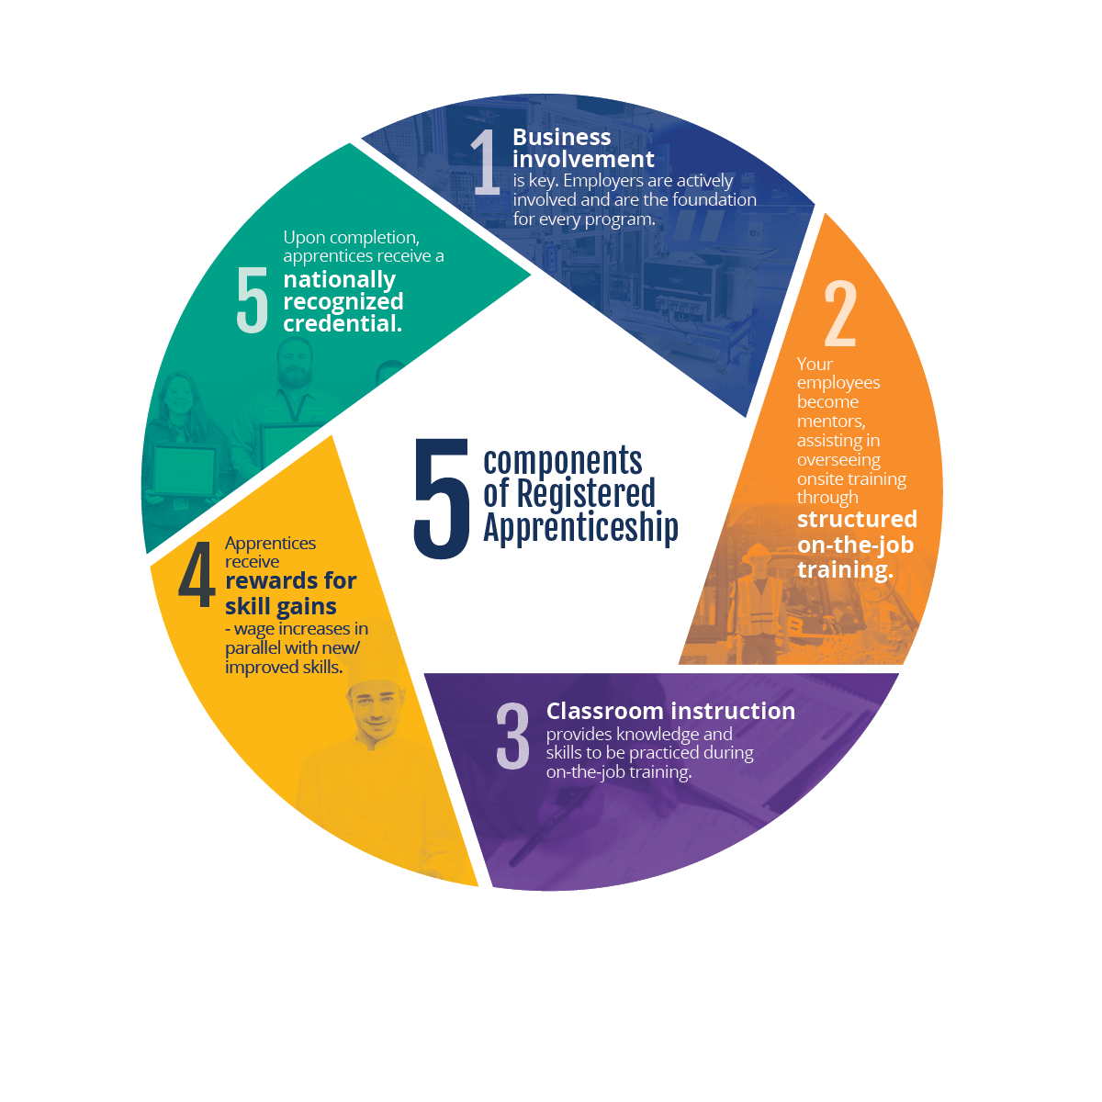
Components
of
Registered Apprenticeship
5 Components:
Employer driven
Structured on-the-job learning
Classroom education
Progressive wages
National industry certificate
ApprenticeshipNH.com/HighSchool

Slide 5
What is Pre-Apprenticeship?
U.S. Department of Labor Definition
Pre-apprenticeship is a program or set of strategies that is designed to prepare individuals to enter and succeed in a Registered Apprenticeship Program.

Slide 6
Flexibility- A Benefit or a Challenge?
Pre-Apprenticeships…
Currently do not need to be registered with the U.S. Dept. of Labor (DOL)
Do not have a required structure-no hour requirements or specified content
Can be delivered by a wide variety of entities: high schools, community organizations, businesses, adult education programs, or colleges.
Can be one class, a series of classes, a work-based learning experience, an extended learning opportunity, two years of a CTE program as well as multiple other options.
With so much flexibility, how do we ensure the programs are high-quality?

Slide 7
Quality Elements
of a
Pre-Apprenticeship
6 Elements:
Approved curriculum
Simulated experience
Facilitated entry
Increased diversity
Supportive services
Sustainable partnerships
ApprenticeshipNH.com/HighSchool

Slide 8
Center for Apprenticeship &
Work-Based Learning
Framework for a High-Quality Pre-Apprenticeship Program
Transparent Entry and Success Requirements
Alignment with skills sought by local employers (Registered Apprenticeships)
Culmination in one or more industry-recognized credentials
Development of skills through hand-on activities and WBL
Offering of academic, career exploration, and wraparound supports
Transition into a Registered Apprenticeship Program

Slide 9
Pre-Apprenticeship Agreements
Identifies the Partners
School(s)
Business or businesses
ApprenticeshipNH-High School Program
Identifies the Purpose and Partner Roles
The type of service provided and by whom
ApprenticeshipNH.com/HighSchool

Slide 10
Pre-Apprenticeship Agreements
Includes Pre-apprenticeship Program Details
Occupation and number of opportunities
Entry requirements
Selection procedures
Program components
Career exploration activities
Academic components
OJL components
Potential credentials
Support services provided
ApprenticeshipNH.com/HighSchool

Slide 11
Pre-Apprenticeship Agreements
Includes Transition to RAP Requirements
Occupations and number of RAP openings
Type of entry-Guaranteed interview or direct entry
Entry requirements
Selection procedures
Advanced placement components
ApprenticeshipNH.com/HighSchool

Slide 12
Questions?

Slide 13
Discussion

Slide 14
Discussion Format
Break into two groups
Read and review sample programs
Identify strengths, barriers, and needs for bringing the program to NH
How can the models be used for different occupations?
Large group share
Repeat

Slide 15
Wrap Up
Thank you for your time!
We will be sending the recording, notes, and a survey.
Please feel free to reach out with questions and ideas!
Contact Us
Anne Banks
abanks@ccsnh.edu
603-230-3544
Mary Ann Gaschnig
mgaschnig@ccsnh.edu
603-230-3536
This ApprenticeshipNH information was created by ApprenticeshipNH, which is part of the Community College System of NH and is licensed under CC BY 4.0. To view a copy of this license, visit: https://creativecommons.org/licenses/by/4.0/

